Slide 1
Enhancing Sentiment Analysis through LSTM
By : Ritika Gadapa & Ashish Yadav

Slide 2

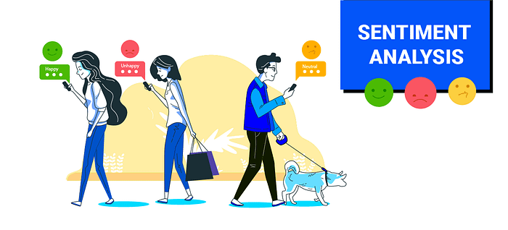
Introduction to Sentiment Analysis
Sentiment analysis is the process of determining the emotional tone behind a body of text, often used to identify opinions in reviews, social media, or feedback.
Commonly applied in fields like marketing, customer service, politics, and finance to gauge public opinion, improve services, or detect trends.
Types of Sentiment: Basic sentiments include positive, negative, and neutral, but more advanced models can detect complex emotions like joy, anger, or sarcasm.
Automation: Machine learning and deep learning techniques, such as LSTM (Long Short-Term Memory), automate sentiment detection, offering higher accuracy and scalability.

Slide 3

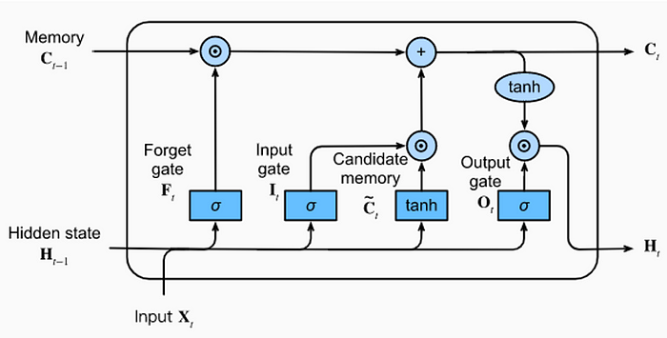
Understanding LSTM Networks
LSTM networks handle sequential data and remember long-term dependencies, solving issues in traditional RNNs.
Structure: They use memory cells and gates (input, forget, output) to control information flow and retention.
Sequential Data: LSTMs excel at tasks like time series prediction and language processing by analyzing entire sequences.
Applications: Commonly used in NLP, machine translation, speech recognition, and sentiment analysis to capture context in sequences.

Slide 4
Key Techniques in LSTM
Data Preprocessing: Involves cleaning text (removing noise, stop words) to ensure the input is accurate and relevant for the LSTM model.
Word Embeddings: Converts words into dense vectors ( Word2Vec, GloVe) that capture semantic meaning, improving LSTM's understanding of text.
Dropout Regularization: Reduces overfitting by randomly dropping units during training, ensuring better generalization of the model.
Batch Normalization: Normalizes inputs across batches to stabilize and speed up training, enhancing LSTM's performance.

Slide 5

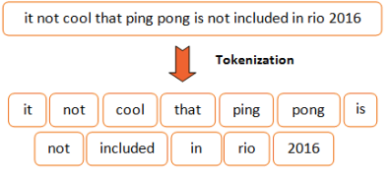
Data Preprocessing Steps
Tokenization: Breaking down text into smaller units like words or subwords , turning text into a sequence of tokens that can be fed into the model.
Padding: Ensuring all input sequences have the same length by padding shorter sequences with zeros or trimming longer ones to fit a fixed size.
Normalization: Removing punctuation, converting text to lowercase, and eliminating stop words or special characters to clean the data.
Encoding: Converting tokens into numerical representations, often through techniques like one-hot encoding or word embeddings for model input​

Slide 6
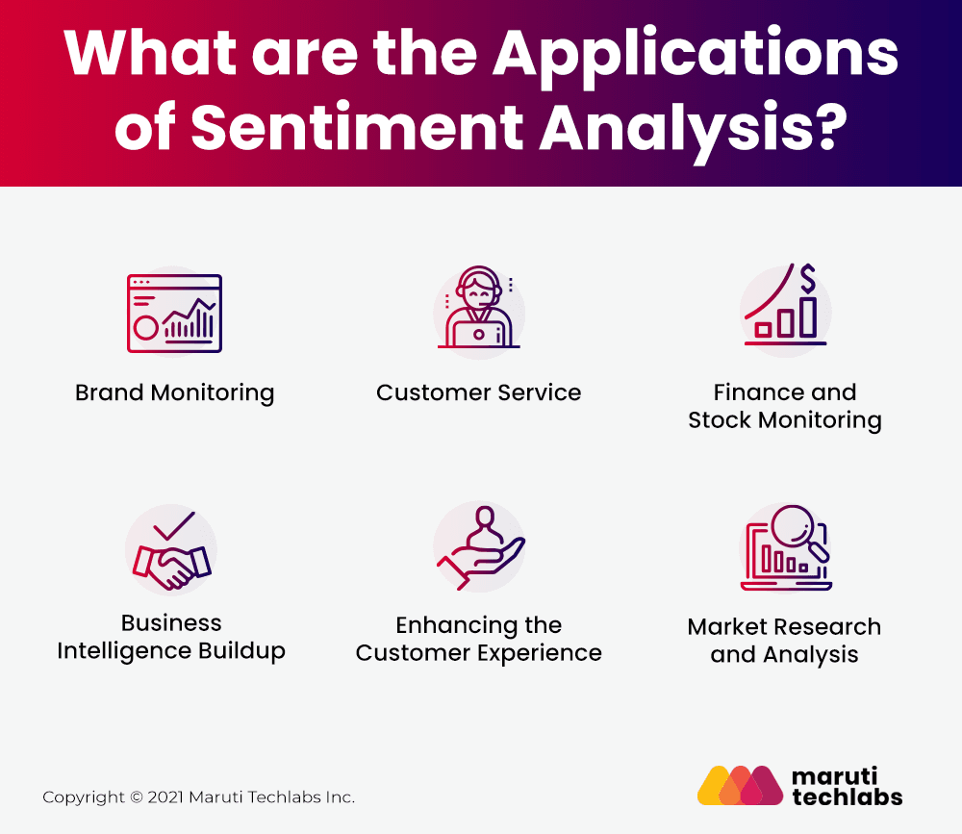
Applications
Social Media Monitoring: LSTM models can analyze user sentiments on platforms like Twitter and Facebook, helping brands gauge public opinion about products, services, or campaigns​.
Customer Feedback Analysis: Businesses use LSTM-based sentiment analysis to process reviews and feedback from customers, identifying areas for improvement and enhancing customer satisfaction​.
Financial Market Predictions: Sentiment analysis of news articles and social media can inform stock market trends, with LSTM models predicting market movements based on public sentiment​.
Political Sentiment Analysis: Analyzing sentiments in political discourse can provide insights into public opinion, voter behavior, and the impact of campaigns, helping political analysts make data-driven decisions​.

Slide 7
Future Trends
Multilingual Sentiment Analysis: Expanding LSTM models to handle multiple languages for global insights.
Real-time Processing: Enhancing LSTM models for faster sentiment detection in live customer interactions.
Emotion Detection: Using LSTM to capture complex emotions beyond positive, negative, or neutral sentiments.
Hybrid Models: Combining LSTM with attention mechanisms or transformers for improved accuracy in sentiment analysis

Slide 8

Conclusion
LSTM is effective for capturing sequential patterns in sentiment analysis.
Future advancements will focus on real-time, multilingual, and emotion-rich insights.
Combining LSTM with newer models like transformers improves accuracy.
Continued innovation will expand LSTM applications in sentiment analysis.
LSTM models will play a key role in refining AI-driven customer experience and feedback analysis.
CODE VIEW

Slide 9

Thanks!

